Slide 1
Eigenvalues and Eigenvectors
1 Eigenvalues and Eigenvectors
2 Diagonalization
3 Symmetric Matrices and Orthogonal Diagonalization

Slide 2
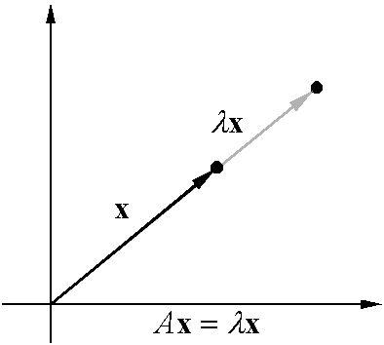

1 Eigenvalues and Eigenvectors
Eigenvalue problem:
  If A is an n×n matrix, do there exist nonzero vectors x in R^{n} such that Ax is a scalar multiple of x？
Eigenvalue and eigenvector:
  A：an n×n matrix
  λ：a scalar
  x： a nonzero vector in R^{n}
Geometrical Interpretation
Eigenvalue
Eigenvector
7 - 1

Slide 3
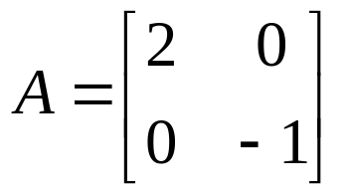
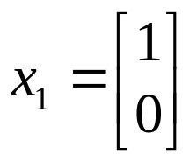
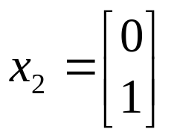
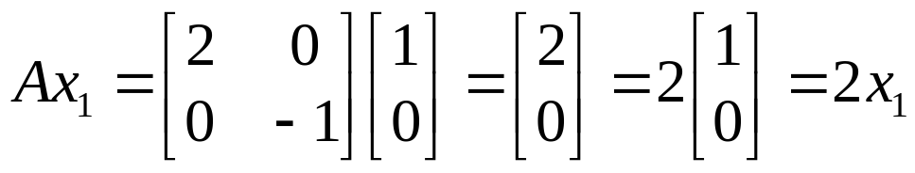
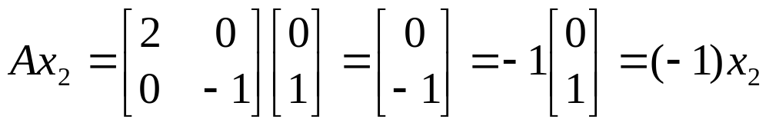
Ex 1: (Verifying eigenvalues and eigenvectors)
Eigenvalue
Eigenvector
Eigenvalue
Eigenvector
7 - <number>

Slide 4

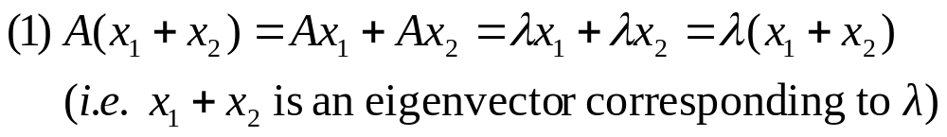
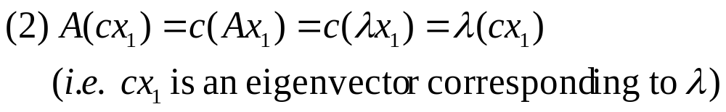
Thm 1: (The eigenspace of A corresponding to λ)
  If A is an n×n matrix with an eigenvalue λ, then the set of all eigenvectors of λ together with the zero vector is a subspace of R^{n}. This subspace is called the eigenspace of λ .
Pf:
  x₁ and x₂ are eigenvectors corresponding to λ
7 - <number>

Slide 5
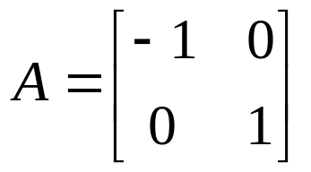

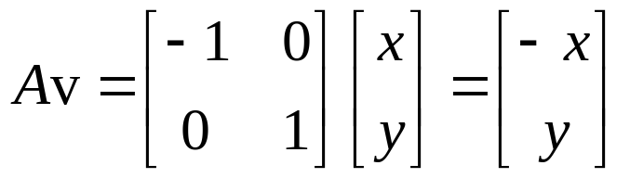

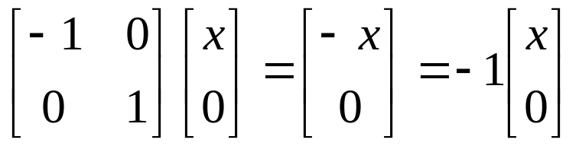
Ex 3: (An example of eigenspaces in the plane)
  Find the eigenvalues and corresponding eigenspaces of
Sol:
If
For a vector on the x-axis
Eigenvalue
7 - <number>

Slide 6

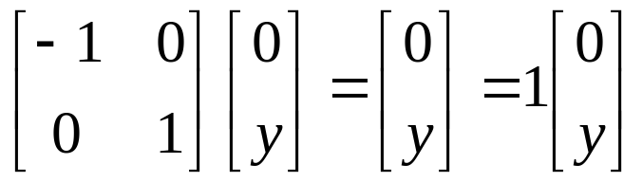
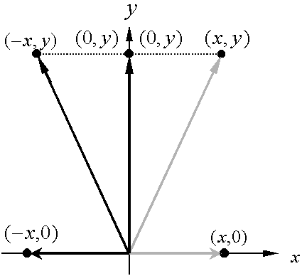


For a vector on the y-axis
Eigenvalue
Geometrically, multiplying a vector (x, y) in R² by the matrix A corresponds to a reflection in the y-axis.
The eigenspace corresponding to is the x-axis.
The eigenspace corresponding to is the y-axis.
7 - <number>

Slide 7



Thm 2: (Finding eigenvalues and eigenvectors of a matrix A∈M_{n×n} )
  Let A is an n×n matrix.
(1) An eigenvalue of A is a scalar λ such that .
(2) The eigenvectors of A corresponding to λ are the nonzero
solutions of .
Note:
(homogeneous system)
If has nonzero solutions iff .
Characteristic polynomial of A∈M_{n×n}:
Characteristic equation of A:
7 - <number>

Slide 8
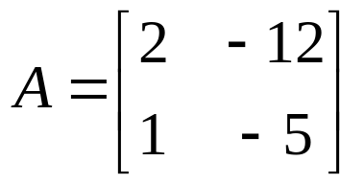
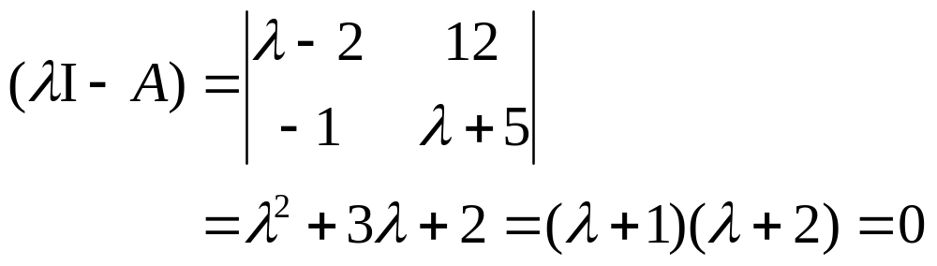


Ex 4: (Finding eigenvalues and eigenvectors)
Sol: Characteristic equation:
Eigenvalue:
7 - <number>

Slide 9
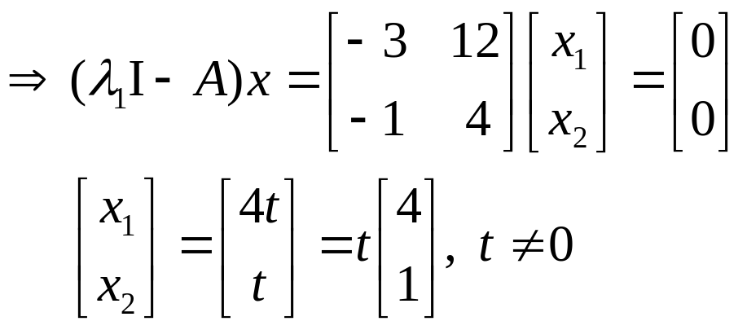

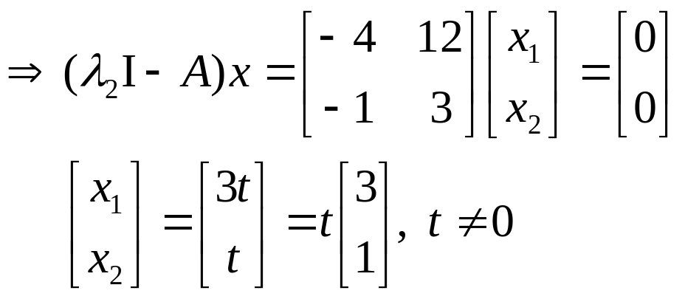

7 - <number>

Slide 10
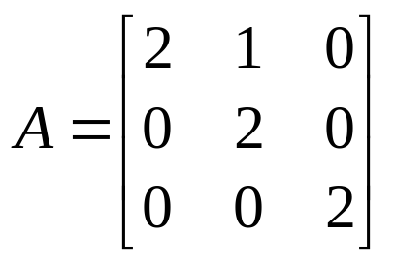
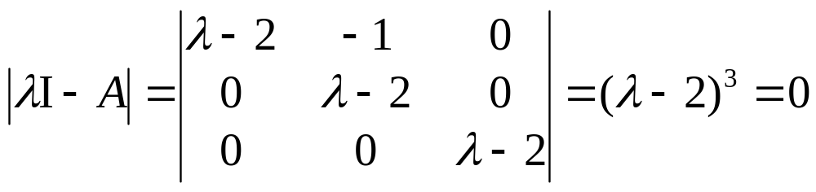

Ex 5: (Finding eigenvalues and eigenvectors)
  Find the eigenvalues and corresponding eigenvectors for the matrix A. What is the dimension of the eigenspace of each eigenvalue?
Sol: Characteristic equation:
Eigenvalue:
7 - <number>

Slide 11
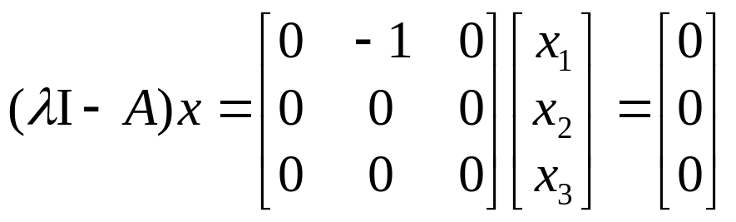
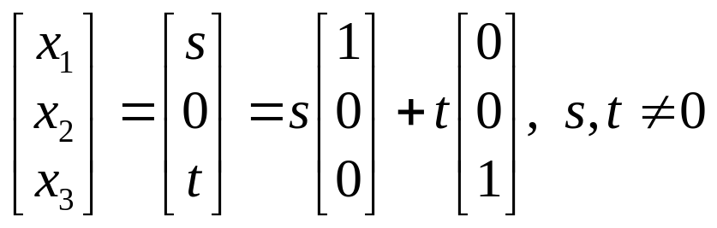
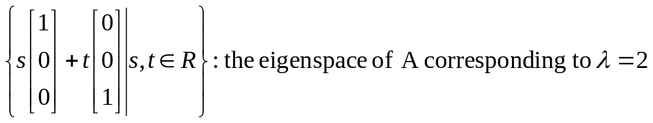
The eigenspace of A corresponding to :
Thus, the dimension of its eigenspace is 2.
7 - <number>

Slide 12
Notes:
(1) If an eigenvalue λ₁ occurs as a multiple root (k times) for the characteristic polynominal, then λ₁ has multiplicity k.
(2) The multiplicity of an eigenvalue is greater than or equal to the dimension of its eigenspace.
7 - <number>

Slide 13
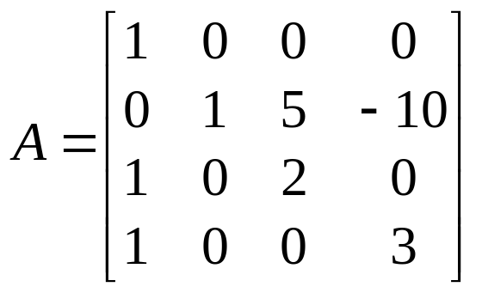
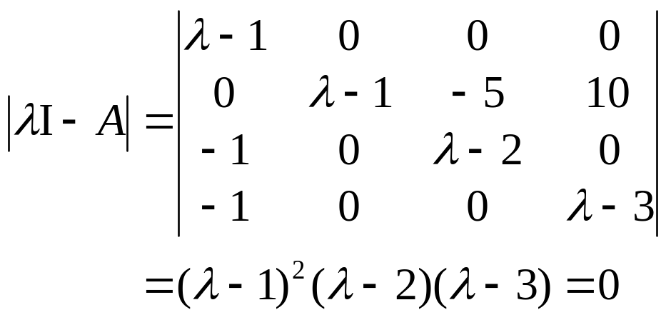

Ex 6：Find the eigenvalues of the matrix A and find a basis
for each of the corresponding eigenspaces.
Sol: Characteristic equation:
Eigenvalue:
7 - <number>

Slide 14
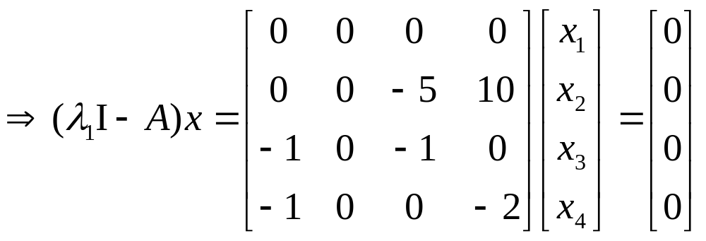

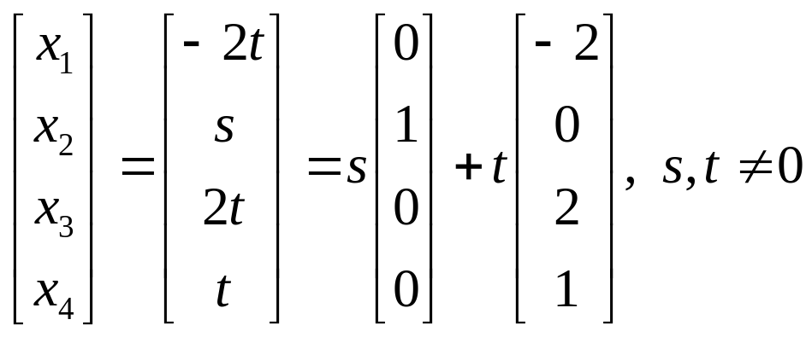
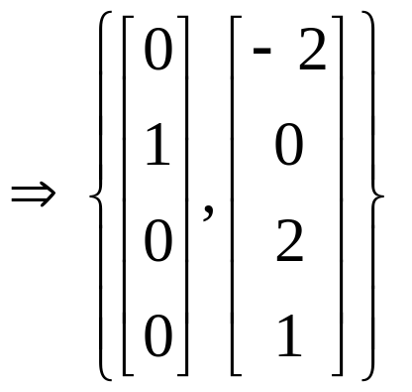

is a basis for the eigenspace of A corresponding to
7 - <number>

Slide 15
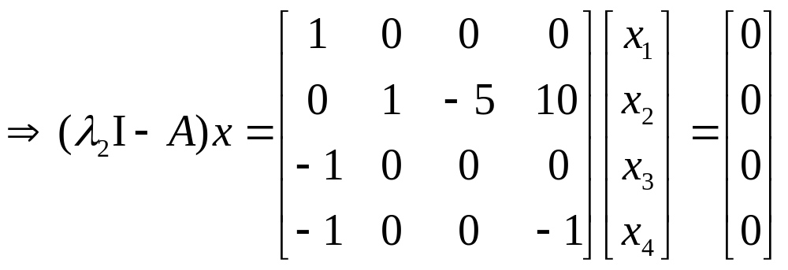

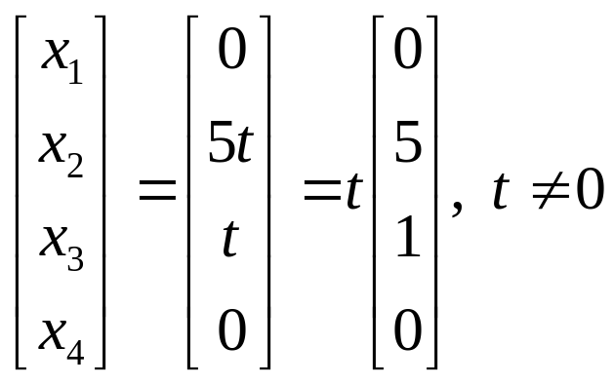
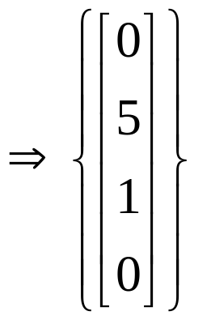

is a basis for the eigenspace of A corresponding to
7 - <number>

Slide 16
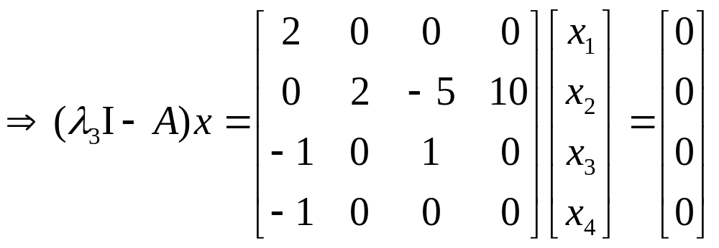

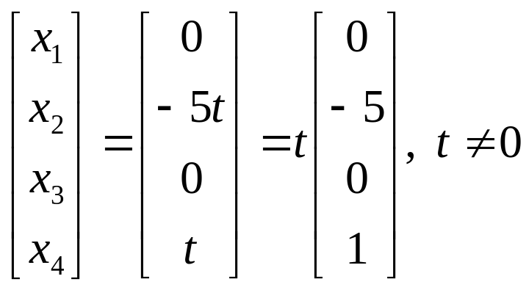
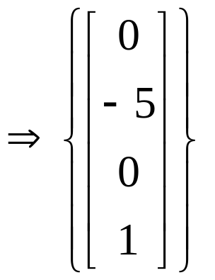

is a basis for the eigenspace of A corresponding to
7 - <number>

Slide 17
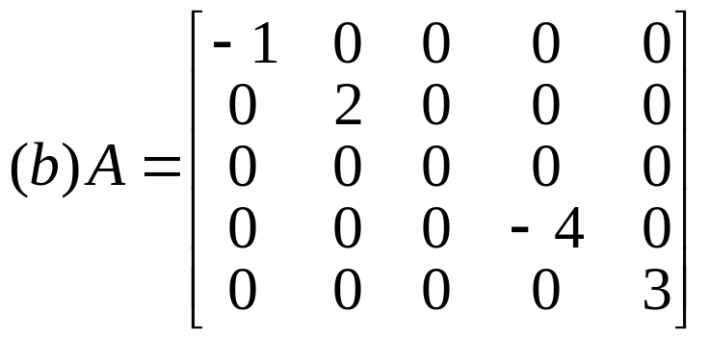
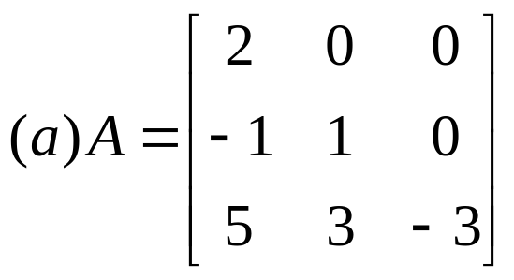
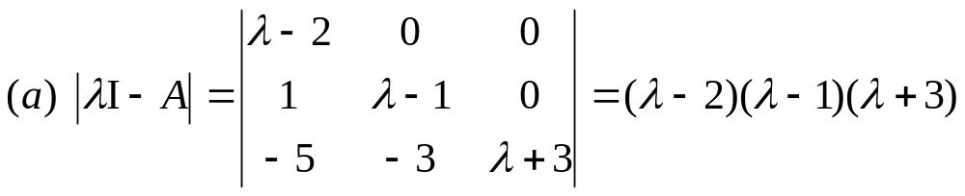

Thm 3: (Eigenvalues for triangular matrices)
If A is an n×n triangular matrix, then its eigenvalues are the entries on its main diagonal.
Ex 7: (Finding eigenvalues for diagonal and triangular matrices)
Sol:
7 - <number>

Slide 18
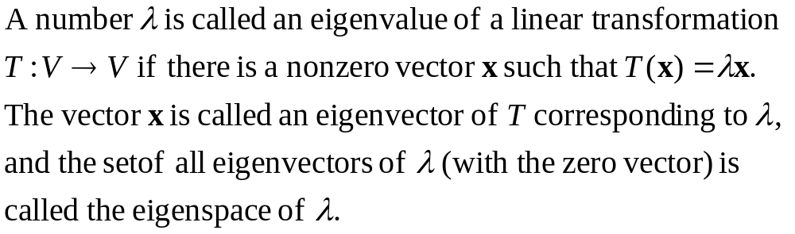
Eigenvalues and eigenvectors of linear transformations:
7 - <number>

Slide 19

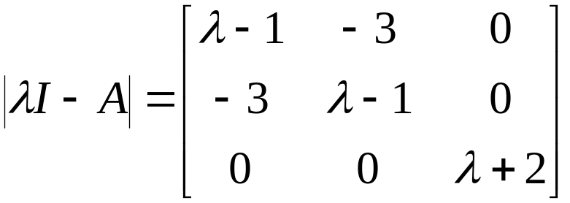


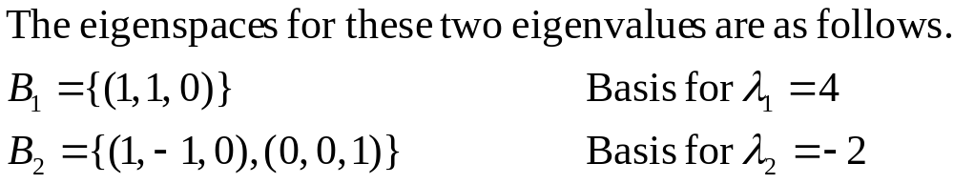
Ex 8: (Finding eigenvalues and eigenspaces)
Sol:
7 - <number>

Slide 20
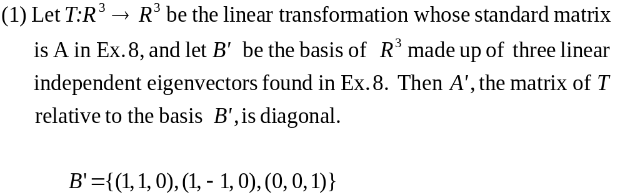
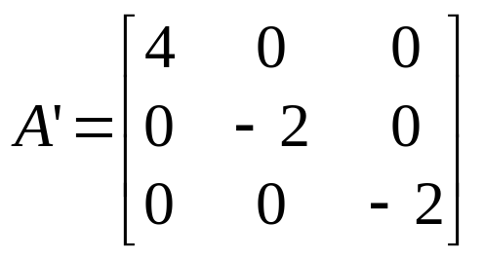


Notes:
7 - <number>

Slide 21

2 Diagonalization
Diagonalization problem:
For a square matrix A, does there exist an invertible matrix P such that P⁻¹AP is diagonal?
Diagonalizable matrix:
A square matrix A is called diagonalizable if there exists an invertible matrix P such that P⁻¹AP is a diagonal matrix.
(P diagonalizes A)
Notes:
(1) If there exists an invertible matrix P such that , then two square matrices A and B are called similar.
(2) The eigenvalue problem is related closely to the diagonalization problem.
7 - <number>

Slide 22
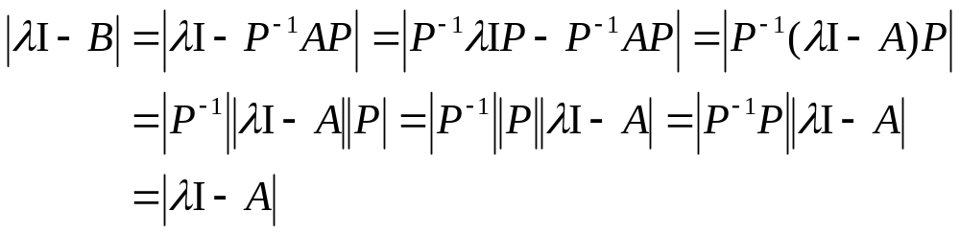
Thm 4: (Similar matrices have the same eigenvalues)
If A and B are similar n×n matrices, then they have the same eigenvalues.
Pf:
Thus A and B have the same eigenvalues.
7 - <number>

Slide 23
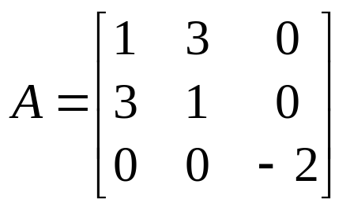
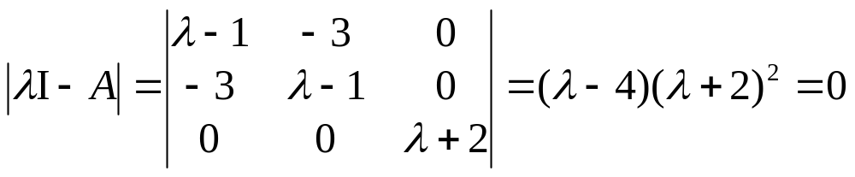
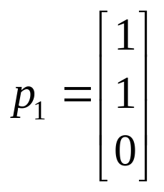

Ex 1: (A diagonalizable matrix)
Sol: Characteristic equation:
7 - <number>

Slide 24
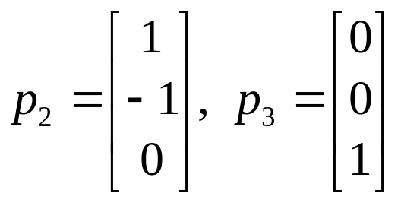

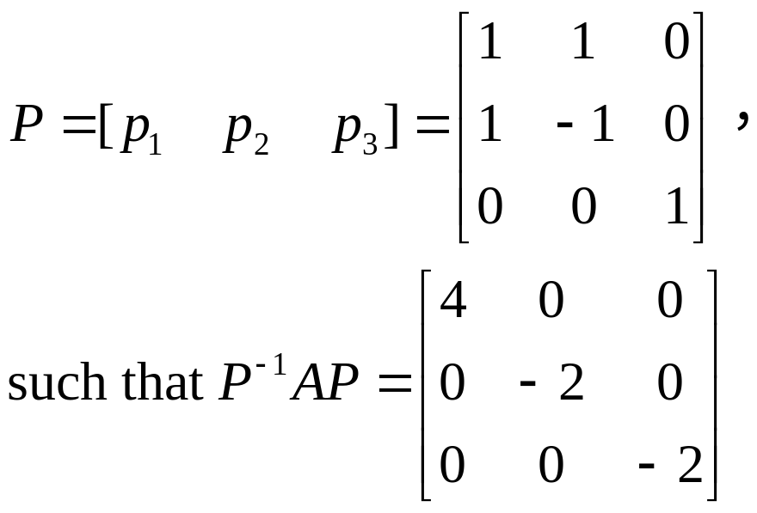
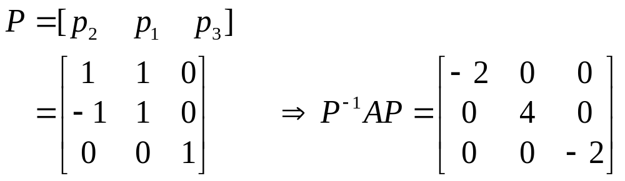
Note: If
7 - <number>

Slide 25

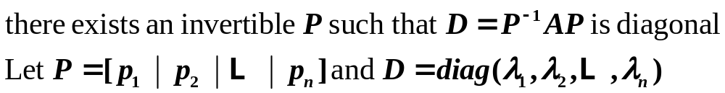
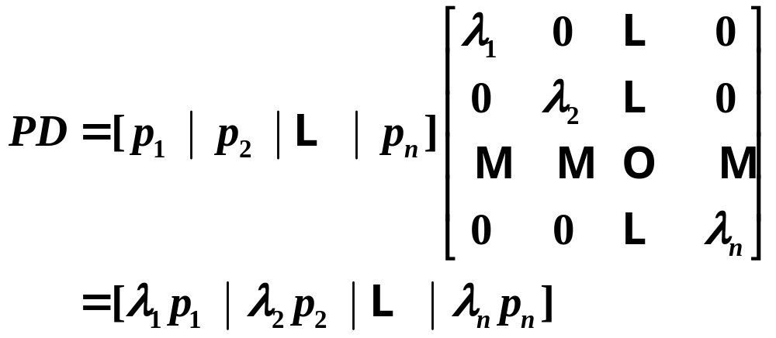
Thm 5: (Condition for diagonalization)
An n×n matrix A is diagonalizable if and only if it has n linearly independent eigenvectors.
Pf:
7 - <number>

Slide 26





7 - <number>

Slide 27


7 - <number>

Slide 28




Ex 4: (A matrix that is not diagonalizable)
Sol: Characteristic equation:
A does not have two linearly independent eigenvectors, so A is not diagonalizable.
7 - <number>

Slide 29




Steps for diagonalizing an n×n square matrix:
Step 1: Find n linearly independent eigenvectors
for A with corresponding eigenvalues.
Step 2: Let
Step 3:
7 - <number>

Slide 30


Ex 5: (Diagonalizing a matrix)
Sol: Characteristic equation:
7 - <number>

Slide 31






7 - <number>

Slide 32




7 - <number>

Slide 33


Notes:
7 - <number>

Slide 34


Thm 6: (Sufficient conditions for diagonalization)
If an n×n matrix A has n distinct eigenvalues, then the corresponding eigenvectors are linearly independent and A is diagonalizable.
Ex 7: (Determining whether a matrix is diagonalizable)
Sol: Because A is a triangular matrix, its eigenvalues are
These three values are distinct, so A is diagonalizable.
7 - <number>

Slide 35


Ex 8: (Finding a diagonalizing matrix for a linear transformation)
Sol:
From Ex. 5 you know that A is diagonalizable. Thus, the three linearly independent eigenvectors found in Ex. 5 can be used to form the basis B. That is
7 - <number>

Slide 36

The matrix for T relative to this basis is
7 - <number>

Slide 37




3 Symmetric Matrices and Orthogonal Diagonalization
Symmetric matrix:
  A square matrix A is symmetric if it is equal to its transpose:
Ex 1: (Symmetric matrices and nonsymetric matrices)
(symmetric)
(symmetric)
(nonsymmetric)
7 - <number>

Slide 38
Thm 7: (Eigenvalues of symmetric matrices)
  If A is an n×n symmetric matrix, then the following properties are true.
  (1) A is diagonalizable.
  (2) All eigenvalues of A are real.
  (3) If λ is an eigenvalue of A with multiplicity k, then λ has k linearly independent eigenvectors. That is, the eigenspace of λ has dimension k.
7 - <number>

Slide 39




Ex 2:
Prove that a symmetric matrix is diagonalizable.
Pf: Characteristic equation:
As a quadratic in λ, this polynomial has a discriminant of
7 - <number>

Slide 40




The characteristic polynomial of A has two distinct real roots, which implies that A has two distinct real eigenvalues. Thus, A is diagonalizable.
7 - <number>

Slide 41

Orthogonal matrix:
A square matrix P is called orthogonal if it is invertible and
Thm 8: (Properties of orthogonal matrices)
An n×n matrix P is orthogonal if and only if its column vectors form an orthogonal set.
Thm 5.9: (Properties of symmetric matrices)
  Let A be an n×n symmetric matrix. If λ₁ and λ₂ are distinct eigenvalues of A, then their corresponding eigenvectors x₁ and x₂ are orthogonal.
7 - <number>

Slide 42




Ex 5: (An orthogonal matrix)
Sol: If P is a orthogonal matrix, then
7 - <number>

Slide 43


7 - <number>

Slide 44

Thm 10: (Fundamental theorem of symmetric matrices)
  Let A be an n×n matrix. Then A is orthogonally diagonalizable and has real eigenvalue if and only if A is symmetric.
Orthogonal diagonalization of a symmetric matrix:
  Let A be an n×n symmetric matrix.
  (1) Find all eigenvalues of A and determine the multiplicity of each.
  (2) For each eigenvalue of multiplicity 1, choose a unit eigenvector.
  (3) For each eigenvalue of multiplicity k≥2, find a set of k linearly independent eigenvectors. If this set is not orthonormal, apply Gram-Schmidt orthonormalization process.
  (4) The composite of steps 2 and 3 produces an orthonormal set of n eigenvectors. Use these eigenvectors to form the columns of P. The matrix will be diagonal.
7 - <number>

Slide 45




Ex 7: (Determining whether a matrix is orthogonally diagonalizable)
Symmetric
matrix
Orthogonally
diagonalizable
7 - <number>

Slide 46



Ex 9: (Orthogonal diagonalization)
Sol:
Linear Independent
7 - <number>

Slide 47




Gram-Schmidt Process:
7 - <number>

